Slide 1
StudyPy Abstract Redesign

Slide 2
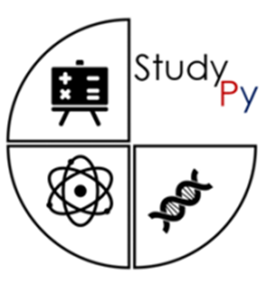
Start page
Start

Slide 3
Intro page
This software’s purpose is to test the users knowledge on two of the modules covered in the second semester through the use of multiple choice questions and the ability to review particular weak areas.
- Data Structures & Algorithms
- Network Fundamentals
Continue

Slide 4
Guest or user?
Would you like to use a Guest account or are you already a user?
Use Guest Account
Make an account
Sign in to account

Slide 5
Create a Account
Input Username:
Create Password:
Re-input password:
This information will give you the ability to track your progress in for your statistics for later.
Submit

Slide 6
Sign in page
Input details to login
Input Username:
Input Password:
Forgot Details
Sign in

Slide 7
Forgot Details Page
If you have forgot your details then please consult one of our admins at the following emails:
Dharmarlou.Bowen@mail.bcu.ac.uk
Stanley.Osuozah@ mail.bcu.ac.uk
Return to Menu

Slide 8
Main Menu
Chose a topic to test your self on:
Data Structure & Algorithms
Networking Fundamentals
Review Statistics (Overall)

Slide 9
Reviewing Stats
Overall Statistics
Data Structure & Algorithm Average Scores :
Data Types = 5/10 (as an example)
Memory Models = 50% (essentially)
Trees & Graphs =
Recursion =
Algorithm Plan =
Searching Algorithms =
Sorting Algorithms =
Efficiency & Correctness =
Network Fundamental Average Scores:
Network Components =
Protocols & Models =
OSI Layers 1 to 7 =
Security Fundamentals =
Data Structure & Algorithm Overall Average: 75%
Network Fundamentals Overall Average: 63%
Return to Menu

Slide 10
DSA Menu
Pick a topic focus:
Data Structures
Algorithms

Slide 11
Data Structure Menu
Pick a topic focus:
Data Types
Memory Models
Trees & Graphs
Recursion

Slide 12
Algorithms Menu
Pick an Algorithm topic:
Algorithms Plans
Searching Algorithms
Sorting Algorithms
Efficiency & Correctness

Slide 13
Network-F Menu
Chose a topic to test your self on:
Network Components
Protocols & Models
OSI Layers 1 to 7
Security Fundamentals

Slide 14
General Intro to a topic
This Quiz will test your know on (Insert Topic here)…
The following content covered will be:
- etc…
- etc…
- etc…
- etc…
- etc…
Start Quiz
Review Previous Attempts
Return to Menu

Slide 15
Quiz Layout Format
Q1) What is the answer to so and so question?
Pick one of the options below:
Answer A
Answer B
Answer C
Next Question
Back to Previous
Return to Menu

